Slide 1
Plan, Commit, Succeed:
Reimagine Your Fundraising Roadmap Through an Effective Development Plan

Slide 2
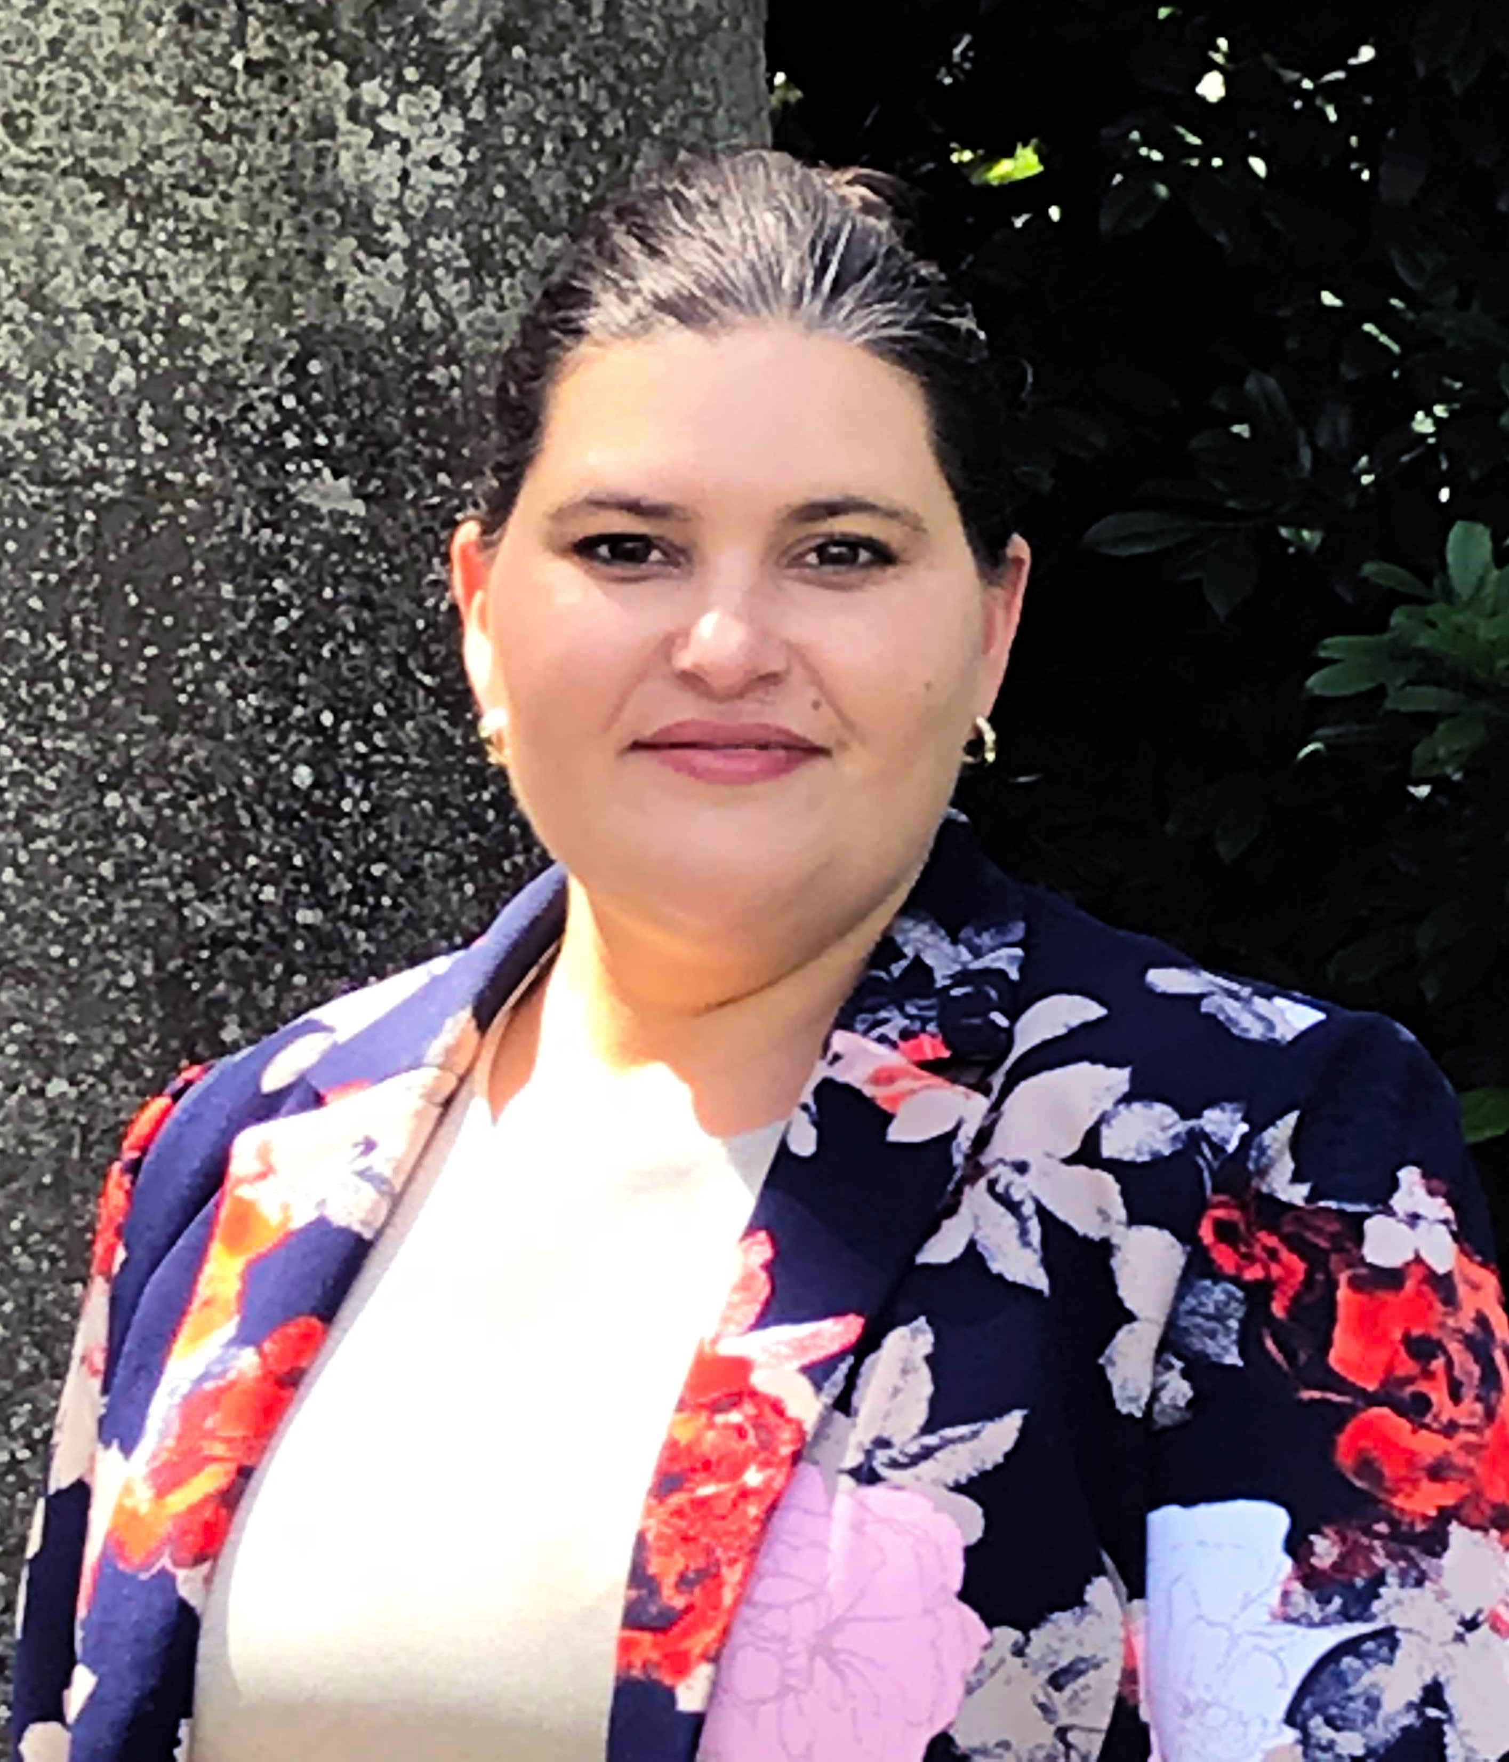

A Bit About Us…
Jennifer Broome, CFRE
Vice President of Philanthropy, Prosperity Now
www.prosperitynow.org
@jnbroome1
Nadine Gabai-Botero, CFRE
President, Focus Fundraising
www.focus-fundraising.com
@focusfund

Slide 3

Get Ready…
How and why to create a plan to guide your fundraising efforts
x

Slide 4
Big Picture Goals
Raise more money
Focus on specific revenue streams
Campaign looming
Address a funding gap
Leadership vision
Standard operating procedure
Notes:
Plan can get complicated or be simple – based on your goals
Note: if it’s “standard operating procedure” plan to add 5-10% to last year’s goals

Slide 5

What Worked (or Didn’t) Last Year?
Review your KPIs
Gifts
Retention
Foundations
Corporations
Notes:
KPI: Key Performance Indicators
Gifts – number of gifts, average gift size
Retention – number of donors, institutional funders, partners year-over-year
Foundations
Size & health of prospect portfolio
Can’t control closing process but can control submissions
Corporations
Number of active prospects
Signed agreements at different levels

Slide 6
What’s New for Next Year?
Consider where you can grow giving or change direction
Build on your successes
Determine which new giving channels you can pursue
Post-Covid: What do you plan to stop doing and what pandemic fundraising activities will you keep?
  Plan (and budget) conservatively for FY22
Notes:
in-person events is one area we can raise for FY22. how to build those back when there’s still uncertainty?

Slide 7
Context: Challenges and Constraints
Resource issues
Internal politics
Pandemic limitations
Mitigating constraints
Scenario planning
Notes:
**What you need to think about when developing goals; establishing the plan**
Resource issues - staffing needs…you know you need help if you’re going to grow but either there isn’t funding or leadership won’t ok the expense
Internal politics - you know you need to build a major donor program but the board doesn't want to be involved
Pandemic limitations – you can raise much more but the lingering effects of Covid may hamper growth or planning

Slide 8
Case Study: Building a Foundation Program from Scratch
American Forests
  2017 budget: $4.5M - corporate and individuals; 2020 budget: $12M ($4M from foundations)
  2017 development plan included strategies to start a foundation program
    No staff; no ability to hire
    Hired a consultant to start the program
    Fundraising team identified prospects and program staff conducted outreach with guidance and participation from development staff
    Raised $1M in first year; $2M in 2018; more than $4M in 2020

Slide 9

Get Set…
Plan Input
Getting Buy-In
Using Templates

Slide 10
Plan Elements
Narrative
  Define your fundraising strategies and tactics by channel
Numbers
  Sketch out revenue expectations by giving channel

Slide 11
Plan Narrative
  Determine your plan audience: leadership, staff, Board etc.
  Will need to “sell” the plan to leadership
  Share your fundraising vision with organizational staff
  Detail goals and tactics for the Board
  Serve as a historical reference

Slide 12
Plan Numbers
  Start with a spreadsheet or accounting software
  Think through the fundraising timeline
  Identify areas for growth/expected reductions
  Prepare to share data with finance
Notes:
Larger orgs often use accounting software for budgeting – i.e. VI360; Intact; Quickbooks

Slide 13
Timing to Create the Plan
Let the organizational budget timeline be your guide
Create the financial portion of the development plan well in advance of the annual budget
For a July 1 – June 30 fiscal year, we recommend beginning your development plan work in February

Slide 14
Timing to Create the Plan
Use your board meeting schedule to guide timing for the plan narrative
Recommend having a draft budget set before creating narrative
Include an executive summary and highlight key elements that differ from previous year(s)

Slide 15
How to Begin
Identify big goals, innovations for next year
Depending on your size:
  Larger nonprofit: each staff lead can create their draft budget to inform the fundraising plan
  Smaller nonprofit/solo development shop:
    Meet with staff, board and/or committees to discuss priorities and get input
    One person (typically Development Director or Executive Director) will draft numbers and schedule meeting(s) to review/adjust
Notes:
Planning is a process that builds on itself
Last year’s plan helps inform next year’s
As time goes on, planning becomes much more detailed and accurate

Slide 16
Example: Plan Narrative - Goals
Major and Mid-Level Donors
  Goal: Retain 40% of FY20 donors; raise $750k in support from new donors
Communications
  Goal: Refine targeted communication strategies for each donor group and ensure at least one touchpoint per segment each month of 2021
Leadership & Systems/Staffing
  Goal: Secure donations from 100% of the Board; engage at least 50% of the board with fundraising activities
  Goal: Move to a new CRM; hire five new development positions

Slide 17
Example: Plan Narrative - Individuals
Summary - Big picture on individual giving (2-3 sentences maximum) to orient reader
  Why do you expect giving to grow or shrink?
  By what percentage do you expecting funding to change?
  Where are the opportunities?
Objective – How individual giving fits into the overall fundraising program (basic information mostly geared for board and possibly CEO)
Strategy – Detail your strategic thinking for this giving channel during the coming year.
Notes:
Objective ex. - While indiv giving still lags institutional support by a large margin, we saw such a big jump in support during Covid that it’s shown us what’s possible so we’ll be hiring and focusing efforts to deepen this area and attract more support
Strategy ex - Build out our major donor program by soliciting transformational gifts and increasing support from mid-level donors with high capacity. Expand new donors through a broader direct mail acquisition program

Slide 18
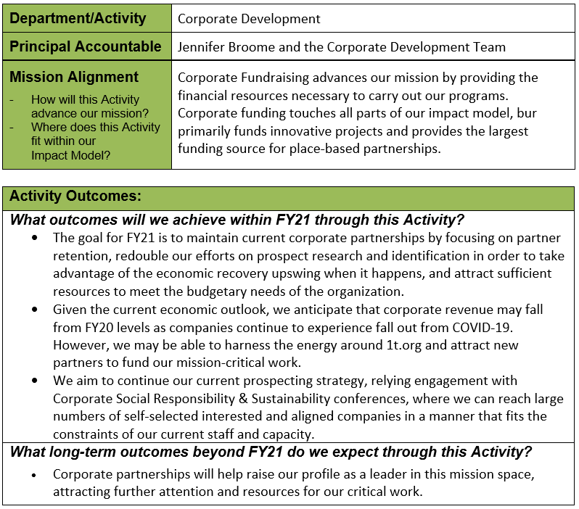
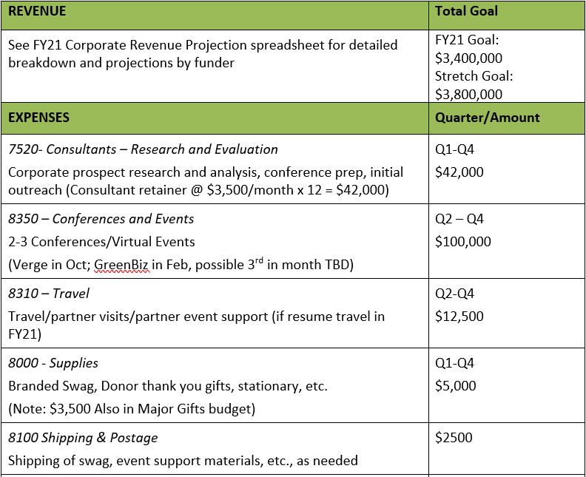
Example Department Activity Plan

Slide 19
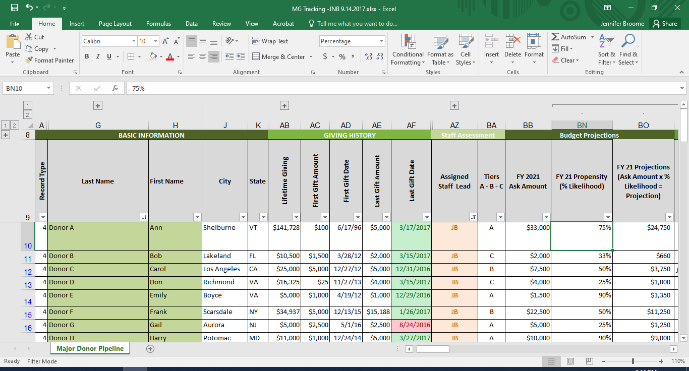
Example – Major Donor Portfolio Pipeline

Slide 20
Getting Input on the Budget and Plan
Large organization: teams of staff built up around revenue streams (individual giving, corporate/foundation, etc.) and you'll need to delegate
Smaller/mid-size organization: You may not have many people on your team, but you will need input from whomever partners with you (CEO, board members, volunteers) to think through the process and goals.
Notes:
NGB to talk abt sm/mid and JB to talk about large
Once you have the numbers drafted they will serve as the start to your work plan and guide the development of your fundraising activities for the coming year.
NOTES re: smaller/mid-sized organizations:
Want to ensure that your plan rolls up effectively to meet the overarching revenue goals. (Sr.-level fundraiser will do this) .
Could be you roll up the numbers and you're short - which revenue streams might you be able to push on to raise a bit more
Perhaps you spread that shortfall over different revenue streams
May need to pull in expenses

Slide 21
Case Study: First-Time Plan & Mid-Year Adjustments
Criminal Justice Reform Organization
[Annual budget: $6M; hired 1st DoD July 2019]
Created first plan which included focus on expanding each giving channel, events, board growth, communications, and systems/staffing
Prioritizing was critical
Influx of support in 2020
2021 Plan - with little donor history, budgeted conservatively for renewals; focusing on retention and systems/staffing growth
Notes:
Prioritizing - systems, communications, board, and donor stewardship prior to new donor cultivation and outreach
Influx of support in 2020: : able to meet the moment but focus had to shift quickly to donor engagement

Slide 22

Pause,
Ponder,
Stretch!

Slide 23
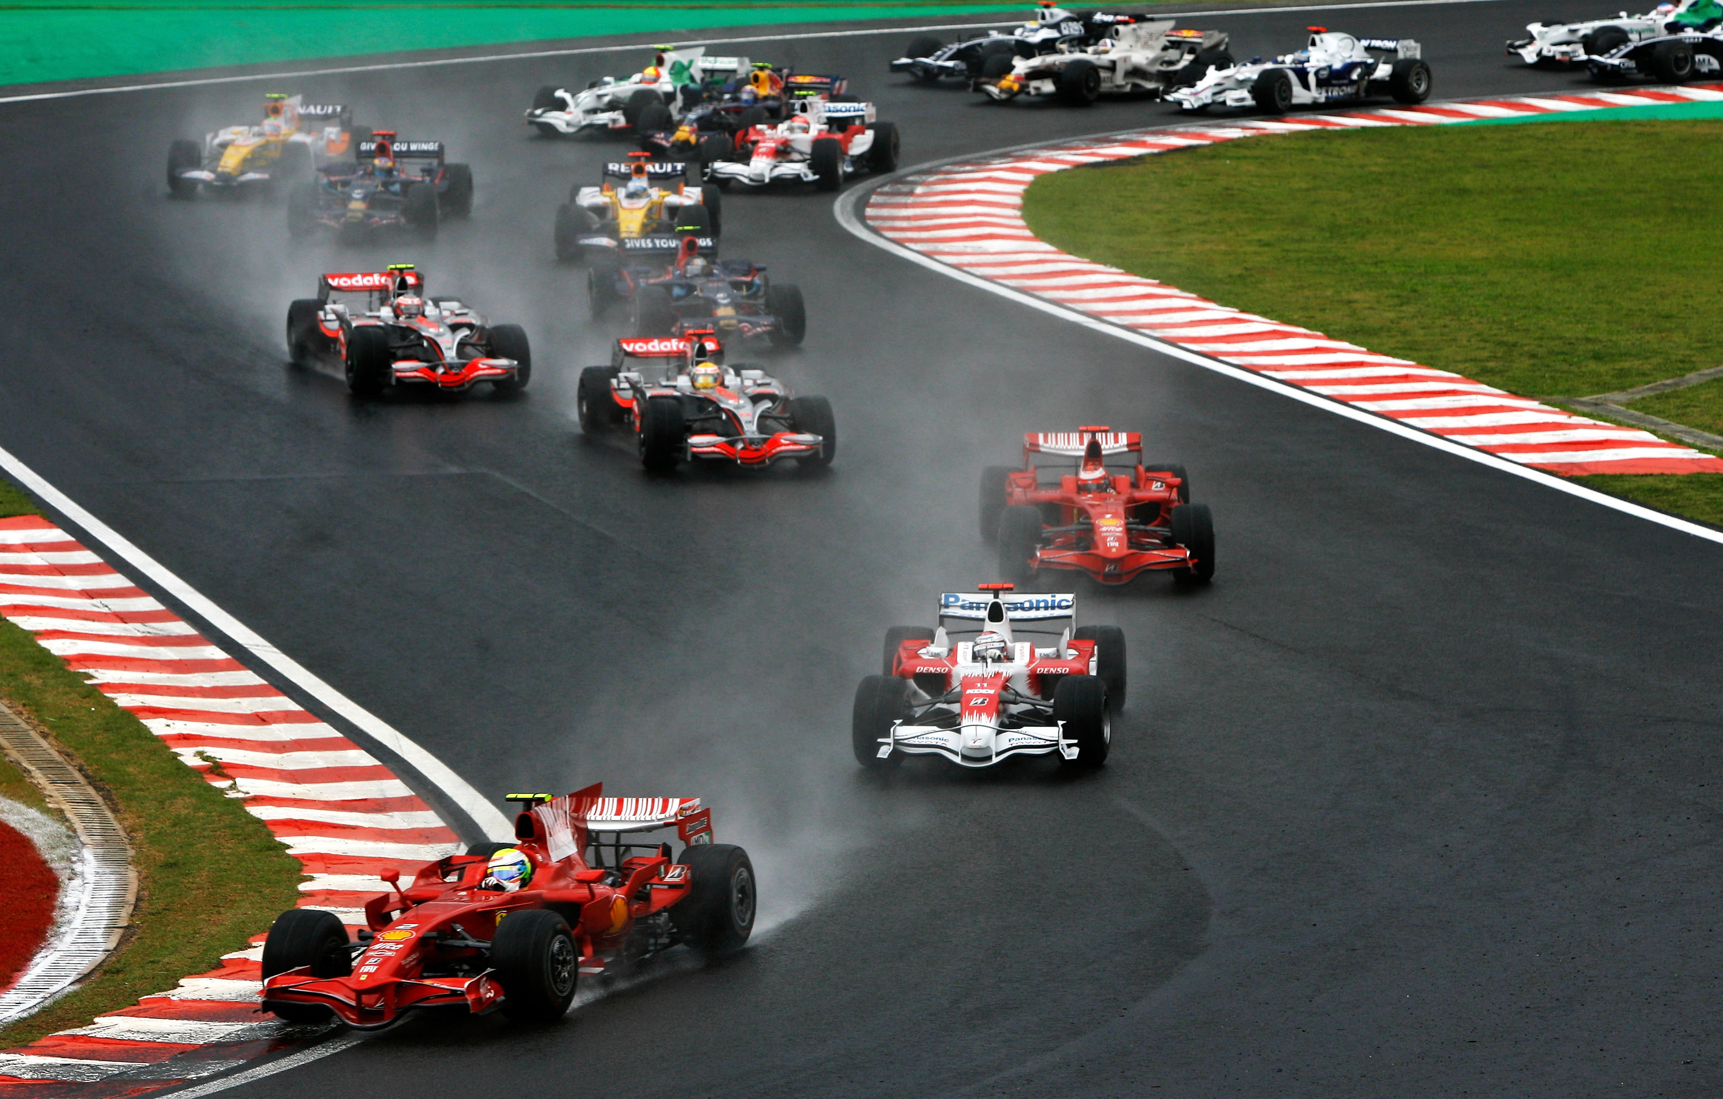
GO! Create Your Plan
Priorities & Goals
Budget
Individuals
Foundations/Corporation
Donor Communications
Systems/Staffing

Slide 24
Your Fundraising Priorities & Goals
Think about them by giving channel (individuals, foundations, etc.) and focus area (communications, systems/staffing, etc.)
Recommend using SMART goals:
  Specific
  Measurable
  Attainable
  Relevant
  Time-bound

Slide 25
Your Organization’s Budget
Include the final approved budget in the plan
  Will likely have to add it in at a later date (once approved)
  Important element for reference, so plan readers have easy access to final numbers as they’re reviewing the plan details
You may have to reforecast at the mid-year point
Remember the plan will guide your team but may ALSO help staff leadership and board understand your fundraising vision
Notes:
The budgeting and performance review processes should be connected, so that you can include in your budget requests any new positions or promotions that need to be funded, and to identify if/where that funding can be identified.

Slide 26
Your Plan: Individuals
Direct Marketing - plan by campaign (Year-end, FY-end, Special month for your organization or related to your mission)
    Integrated Mail
    Email Appeals
Mid-Level Giving
    Hybrid of direct marketing and some personalized outreach
    Half of portfolio could be individually-focused and half on communications/engagement efforts.

Slide 27
Your Plan: Individuals
3. Major Gifts - plan based on individuals with moves management focus. Each person will have a dedicated line in your related spreadsheet)
    Personalized solicitation
4. Planned Giving - depending on how mature your program is, plan could be focused by:
    Donor
    Staff who is leading this work (based on donor interaction goals), or
    Communication efforts (types of outreach planned)

Slide 28
Example: Individuals
Summary Direct Mail Plan:
  4 Acquisitions (February, May, September, November)
  4 Renewals (January, February, March, April)
  2 Lapsed Reinstatements (January & February)
  4 Appeals (June, September, November, December)
  2 Planned Giving Appeals (July & August)
  3 Stewardship pieces (Welcome Kit, January Tax Letters, & October Annual Report)

Slide 29
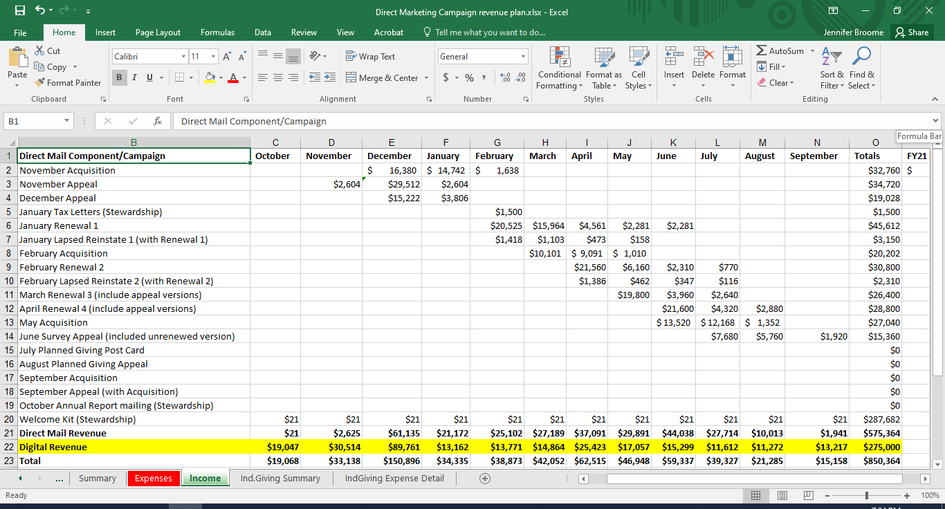
Notes:
Mention that if they want to use this, they just need to recreate the template in Excel

Slide 30
Example: Individuals
Principal Donors ($10k+)
    Meetings
    Proposals/individualized appeals
Mid-Level ($1k-$10k)
    Communication efforts/newsletter
    Renewal schedule
Annual Fund (up to $1k)
    Direct mail appeals
    Email appeals
Outreach / Events
Planned Giving

Slide 31
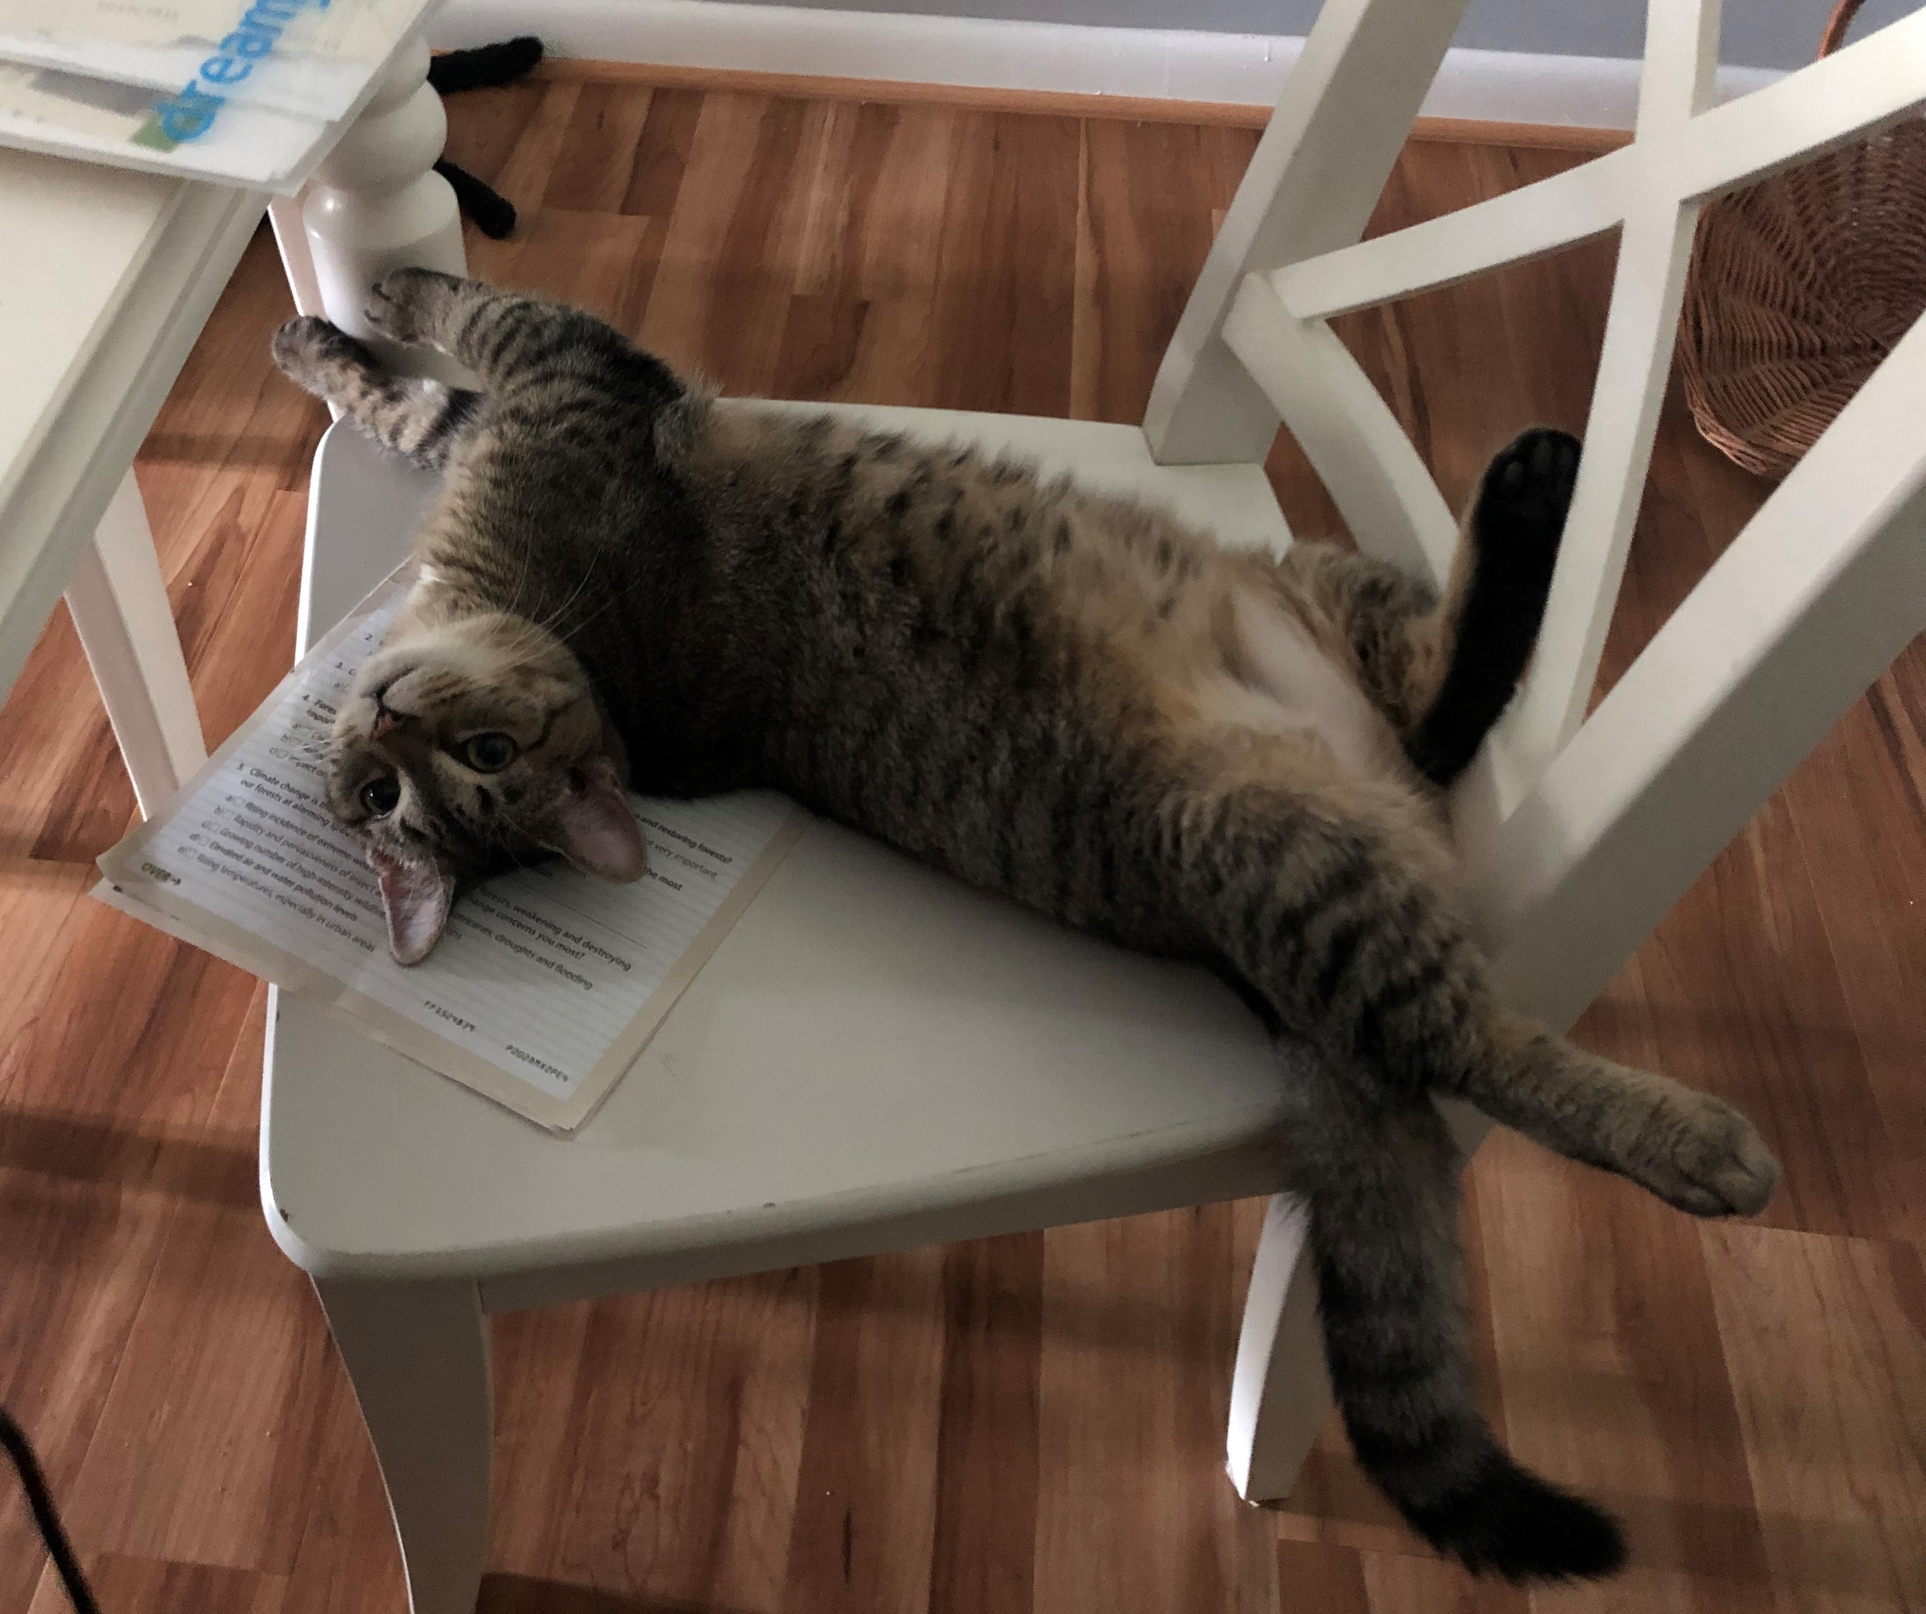
Pause,
Ponder,
Stretch
Part 2!

Slide 32
Your Plan: Foundations/Corporations
In spreadsheet: each foundation will get its own line
  Include Lead person, Source, Location, last year's gift, FY21 ask amount, likelihood percentage, expected revenue amount, and amount received and difference
  Also include where the funding goes to - this helps the development team know which programs have a surplus and which need funding still, it'll guide on where dev staff should focus attention

Slide 33
Your Plan: Foundations/Corporations
Quarterly reconciliation process with finance to determine where the funds were allocated - can also be done monthly
  Monthly on gift processing side but fundraising team only gets involved quarterly.
  This process is so critical to make sure that funding is clear btwn dev and finance
  On the spreadsheet, want to see growth and details (managed by the dept head/manager)

Slide 34
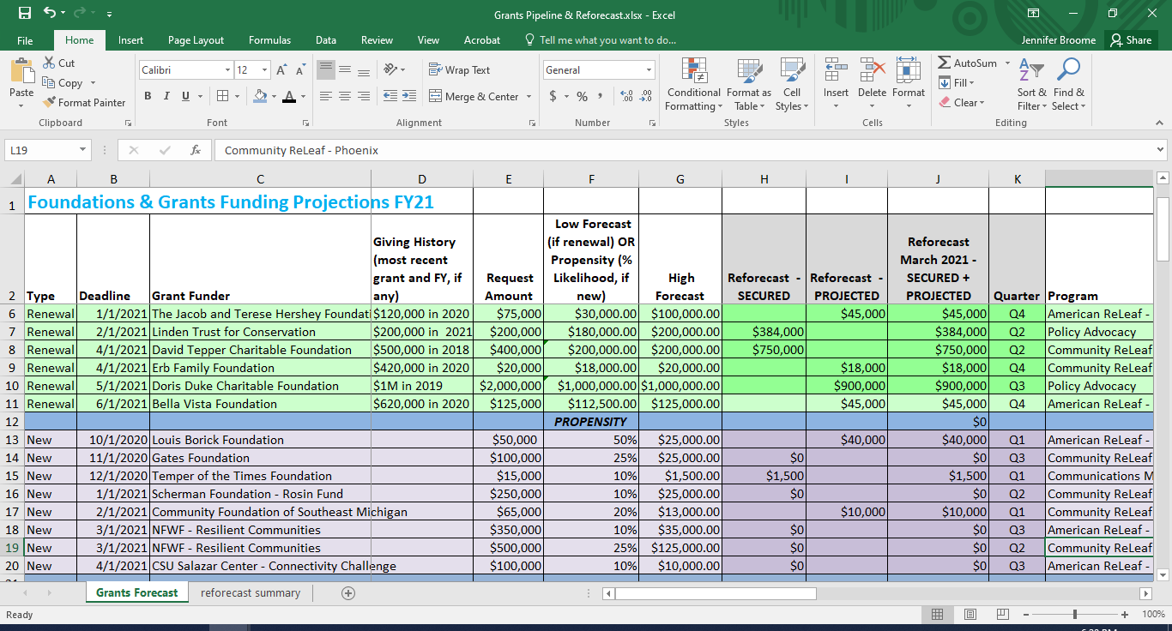
Notes:
Discuss multi-year commitments and how to best show the carry-forward
--Dev Plan needs to align work plans because program staff will be working on funded initiative / dev team stewarding the donor
--GAAP rules state funding has to be realized in Year 1 so won’t be able to go back to funder in successive years that the grant is active

Slide 35
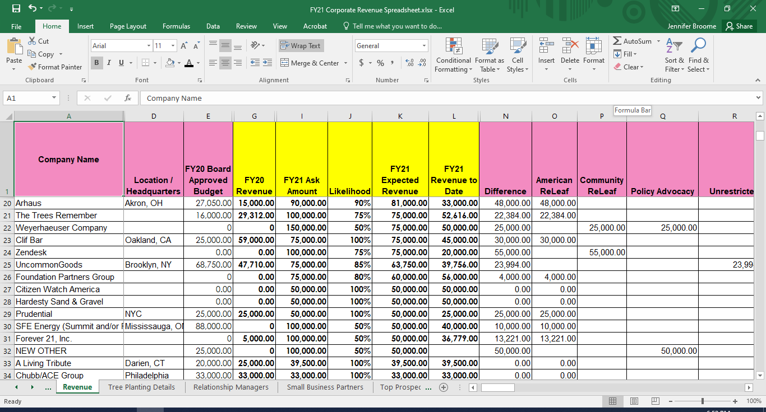
Notes:
Highlight “New Other” line 32 as important for planning

Slide 36
Foundations/Corporations
Organize plan section by strategies and tactics:
  Corporations: Strengthen ties with current corporations via expanded engagement opportunities
    Update benefits and renewal strategies
    Plan Spotlight Talks to connect corporate staff with our mission
    Strengthen volunteer opportunities for corporate employees

Slide 37
Foundations/Corporations
  Foundations: Engage program officers with new plans and impact data
  Hire new position to serve as relationship manager for each new 2020 funder
  Revise case for support for institutional funders
  Submit 3-5 foundation proposals per month

Slide 38
Donor Communications
Larger vs. smaller/mid-sized organizations may include comms in different ways
Can wrap the donor-focused communications within the sections they pertain to (so annual appeals would be detailed under individuals) or pull out to its own section only focused solely on communications
  Appeals
  Newsletters
  Special Impact Reports

Slide 39
Systems and Staffing
This could be its own section or you could weave it into the different revenue channel areas
  If you need to invest in a new database, detail it under direct marketing as that's where you'd charge it
  A new major gifts officer hire could be included in the “individuals” section
  Or have a "systems/staffing" section that outlines the different ways you'll invest in these areas
Could also include new hires or consultant/contract support here
Notes:
Timing of plan should align with both budgeting and performance evaluations!

Slide 40

Keep Your Plan Relevant
Engaging Your Team/Staff
Adapting to Challenges
Re-forecasting

Slide 41
Engaging Your Team
As a team member or the senior person on a team (VP or DoD), you've got to collaborate/delegate as you implement the plan
Engage senior leadership and board members
  Think about what you and your team want to stop doing as much as what you want to add in the coming year
  If there’s anything new, big, expensive in the plan, socialize those ideas before it shows up in the plan
Whose job is it to consistently review/focus on the plan all year?
Notes:
Determine who’s role it is to determine when to:
start activities
when to hold on new initiatives, and
how focused you should stay on planned timing for initiatives

Slide 42
Using Reforecasting to Manage Change
Plan for a mid-year adjustment to the budget and development plan
  Reforecasting is a normal part of budgeting process
  Usually done mid-year (in 2020, many nonprofits did it 2, 3, or more times)
Stay focused on revenue as well as expenses
  If revenue is up, plan to spend more
  If revenue is coming up short, where can you rein in expenses?
Focus on what is in your control

Slide 43
Managing Challenges
Thinking ahead to 2022
Keep an eye on larger economic trends
Implications of strategic planning
  Re-organization and/or staffing shifts
  New or changing programmatic direction
Notes:
Annual Giving USA reports and others help you understand broader environment that could impact giving in current or next year(s)

Slide 44
Ongoing Planning Process
Keep a running list of budget adjustments for next year’s plan
Sketch out potential staffing structural changes
Timing for when to start the process
Notes:
Examples for running list:
Things that weren’t approved or didn’t get to add in current year you’d like to add for next year (staffing, technology, new initiatives)
Economic elements that could impact giving:
Corporate giving may shift with increased taxes (may need to scale back corp expectations)
Recession could impact individual giving; foundation giving usually lags

Slide 45
Handouts
Development Plan Template
“Key Issues in the Fund Development Planning Process” by Simone Joyaux

Slide 46
Thank You!
Jennifer Broome, CFRE
Vice President of Philanthropy, Prosperity Now
www.prosperitynow.org
@jnbroome1
Nadine Gabai-Botero, CFRE
President, Focus Fundraising
www.focus-fundraising.com
@focusfund

